Slide 1

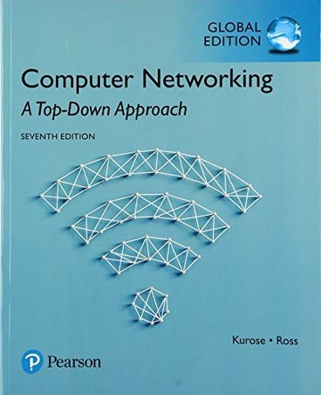
Link Layer and LANs - Roadmap
introduction
error detection, correction
multiple access protocols
LANs
addressing, ARP
Ethernet
switches
Chapter 6.1- 6.4.3

Slide 2

Parity checking
single bit parity:
detect single bit errors
two-dimensional bit parity:
detect and correct single bit errors
14% overhead
row parity
0111000110101011
1
d_{1,1}
. . .
d_{1,j}
d_{1,j+1}
d data bits
d_{2,1}
. . .
d_{2,j}
d_{2,j+1}
parity
bit
. . .
. . .
. . .
. . .
d_{i,1}
. . .
d_{i,j}
d_{i,j+1}
column
parity
d_{i+1,1}
. . .
d_{i+1,j}
d_{i+1,j+1}
Even parity: add an extra bit called parity bit to keep the number of 1’s even
Detects 1-bit errors and some 2-bit errors
Not reliable against bursty errors
no errors:
1 0 1 0 1 1
detected
and
correctable
single-bit
error:
1 0 1 0 1 1
1 1 1 1 0 0
1 0 1 1 0 0
parity
error
0 1 1 1 0 1
0 1 1 1 0 1
1 0 1 0 1 0
1 0 1 0 1 0
parity
error

Slide 3
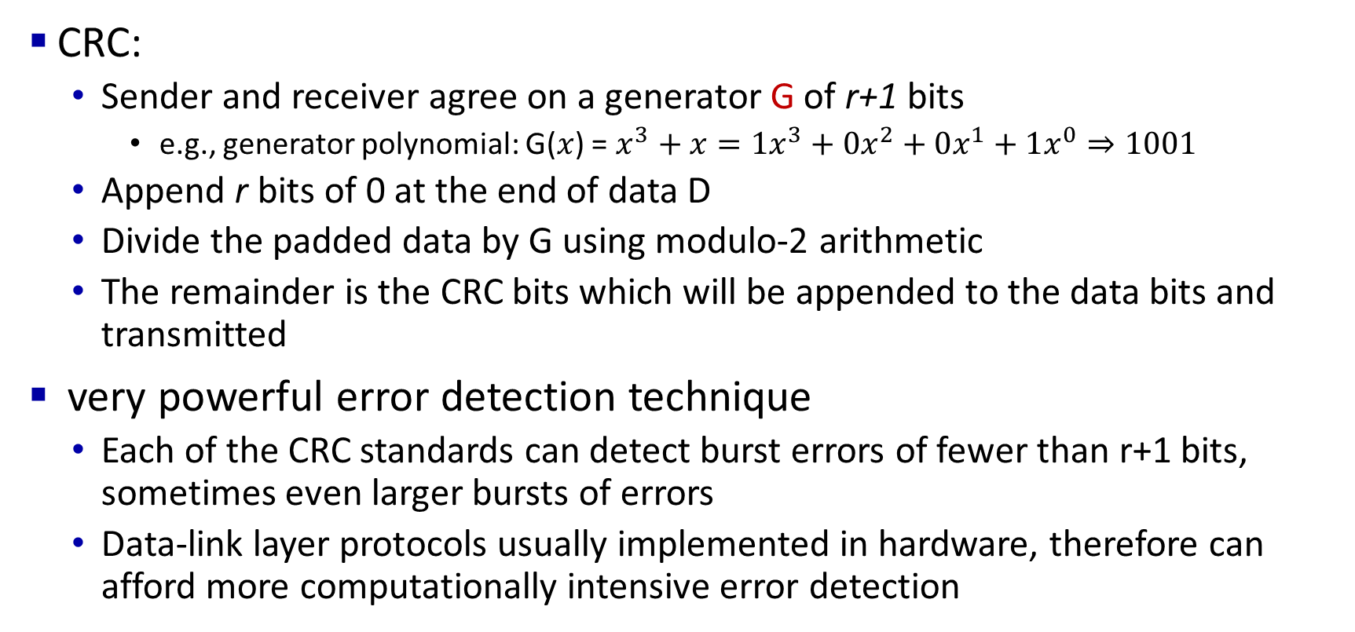
Cyclic Redundancy Check (CRC)
CRC:
Sender and receiver agree on a generator G of r+1 bits
e.g., generator polynomial: G($x$) = $x^{3}+x=1x^{3}+0x^{2}+0x^{1}+1x^{0}⇒1001$
Append r bits of 0 at the end of data D
Divide the padded data by G using modulo-2 arithmetic
The remainder is the CRC bits which will be appended to the data bits and transmitted
very powerful error detection technique
Each of the CRC standards can detect burst errors of fewer than r+1 bits, sometimes even larger bursts of errors
Data-link layer protocols usually implemented in hardware, therefore can afford more computationally intensive error detection

Slide 4
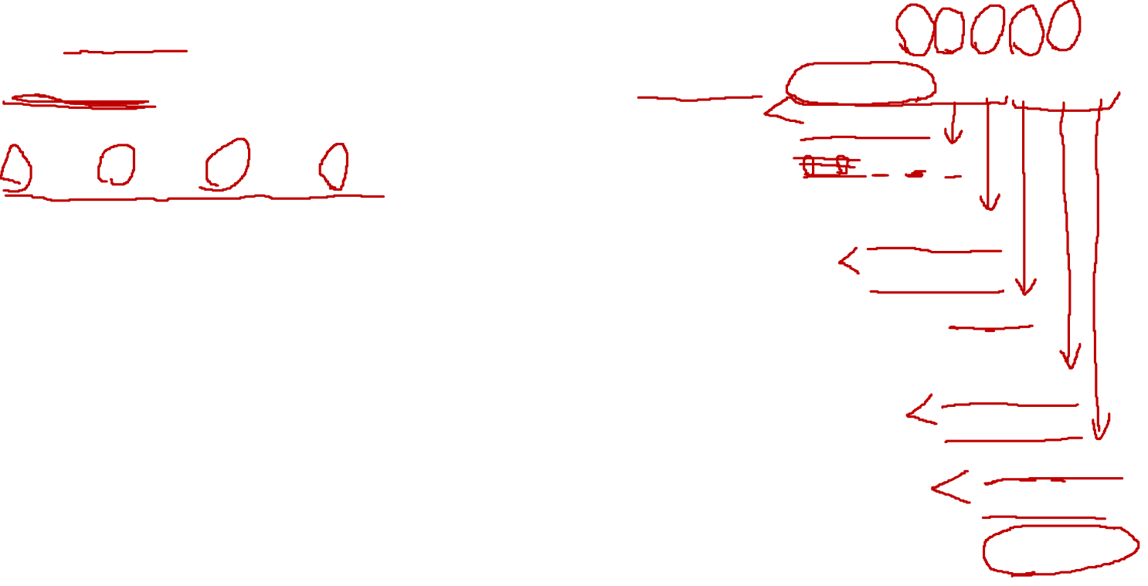
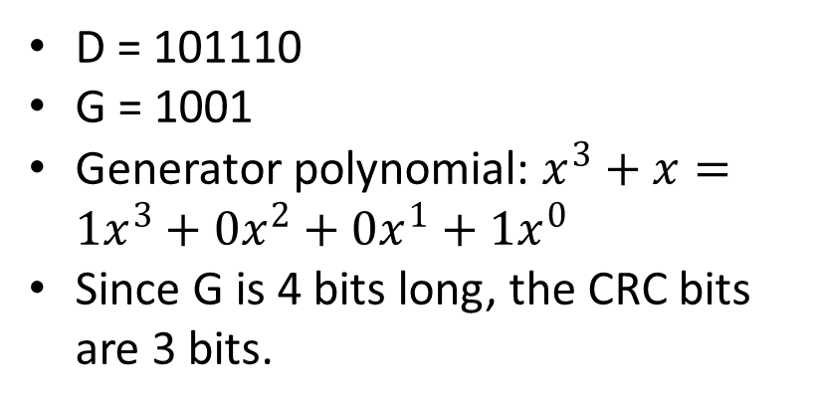
Cyclic Redundancy Check (CRC): example
G
1
0
1
D = 101110
G = 1001
Generator polynomial: $x^{3}+x=1x^{3}+0x^{2}+0x^{1}+1x^{0}$
Since G is 4 bits long, the CRC bits are 3 bits.
0 1 1
1 0 0 1
1 0 1 1 1 0
0 0 0
1 0 0 1
1 0 1
D
2^{r}
0 0 0
*
1 0 1 0
1 0 0 1
1 1 0
Append 3 bits of 0 at the end of data D
Divide the padded data by G using modulo-2 arithmetic
Finally, the 3-bit long remainder is the CRC bits which will be appended to the data bits at the sender side before the transmission
0 0 0
1 1 0 0
1 0 0 1
1 0 1 0
1 0 0 1
0 1 1
R

Slide 5
Random access protocols
when node has packet to send
transmit at full channel data rate R.
no a priori coordination among nodes
two or more transmitting nodes: “collision”
random access MAC protocol specifies:
how to detect collisions
how to recover from collisions (e.g., via delayed retransmissions)
examples of random access MAC protocols:
ALOHA, slotted ALOHA
CSMA, CSMA/CD, CSMA/CA

Slide 6

Pure ALOHA
unslotted Aloha: simple, no synchronization
when frame first arrives: transmit immediately
Receivers ACK all received packets
No ACK = collision, wait a random time then retransmit
In the following example scenario,
frame sent at t₀ collides with the other frame sent in [t₀-1,t₀]
will overlap
with start of
i’s frame
will overlap
with end of
i’s frame
t₀ - 1
t₀
t₀ + 1

Slide 7
Slotted ALOHA
assumptions:
all frames same size
time divided into equal size slots (time to transmit 1 frame)
nodes start to transmit only slot beginning
nodes are synchronized
if 2 or more nodes transmit in slot, all nodes detect collision before the slot ends
operation:
when node obtains fresh frame, transmits in next slot
if no collision: node can send new frame in next slot if it has one
if collision: node retransmits frame in each subsequent slot with probability p until success (like tossing a biased coin)

Slide 8

Slotted ALOHA: performance
efficiency: long-run fraction of successful slots (many nodes, all with many frames to send)
suppose: N nodes with many frames to send, each transmits in slot with probability p
prob that a given node has success in a slot = p(1-p)^{N-1}
For all N nodes, the efficiency of slotted ALOHA = Np(1-p)^{N-1}
max efficiency: find p* that maximizes Np(1-p)^{N-1}
for many nodes, take limit of Np*(1-p*)^{N-1} as N goes to infinity, gives:
max efficiency = 1/e = .37
at best: channel is used for useful transmissions for 37% of time!

Slide 9
CSMA/CD
Carrier sense multiple access with collision detection
Algorithm
Listen to the channel
If channel is busy, wait until idle
Sending would cause a collision and waste time
Send a frame and sense for collision
If no collision, then frame has been delivered
If collision, abort immediately (stops transmission)
Why keep sending if the frame is already corrupted?
Perform exponential backoff then retransmit

Slide 10
Exponential Backoff
When a sender detects a collision, send “jam signal”
Make sure all hosts are aware of collision
Jam signal is 32 bits long (plus header overhead)
Exponential backoff
Select k ∈ [0, 2^{n} – 1], where n = number of collisions
Wait k * the amount of time required to send 512 bits (e.g., k * 51.2µs for 100 Mbps Ethernet) before retransmission
n is capped at 10, frame dropped after 16 collisions
The size of the sets from which k is chosen grows exponentially with the number of collisions – exponential backoff

Slide 11
CSMA/CA
Carrier Sense Multiple Access / Collision Avoidance
Like CSMA/CD, CSMA/CA it is also operated in the medium access control layer.
Unlike CSMA/CD (that is effective after a collision), CSMA / CA is effective before a collision
Algorithm
prior to transmitting, a node first listens to the shared medium (such as listening for wireless signals in a wireless network) to determine whether another node is transmitting or not.
if another node was heard, wait for a period of time (usually random) for the node to stop transmitting before listening again for a free communications channel.
if the medium was identified as being clear then it can send the frame in its entirety.

Slide 12
CSMA/CD vs CSMA/CA
S.NO | CSMA/CD | CSMA/CA
1. | CSMA / CD is effective after a collision. | Whereas CSMA / CA is effective before a collision.
2. | CSMA / CD is used in wired networks. | Whereas CSMA / CA is commonly used in wireless networks.
3. | It only reduces the recovery time. | Whereas CSMA/ CA minimizes the possibility of collision.

Slide 13

ARP: address resolution protocol
Question: how to determine interface’s MAC address, knowing its IP address?
ARP table: each IP node (host, router) on LAN has table
ARP
137.196.7.78
IP/MAC address mappings for some LAN nodes:
< IP address; MAC address; TTL>
TTL (Time To Live): time after which address mapping will be forgotten (typically 20 min)
1A-2F-BB-76-09-AD
ARP
ARP
LAN
71-65-F7-2B-08-53
58-23-D7-FA-20-B0
137.196.7.23
137.196.7.14
ARP
0C-C4-11-6F-E3-98
137.196.7.88

Slide 14
Thank You!

